Slide 1



DETERMINANTS OF SALARY PACKAGES IN INDIAN COMPANIES: A MULTIPLE REGRESSION ANALYSIS
Group Members:
  Anmol Sai Ramchandran
  Devang Chaturvedi
  Kanishk Deshwal
  Shreyas Pantangi

Slide 2

Problem Statement
Objective
  Understand which company attributes significantly influence salary packages.
  Build an interpretable multiple regression model.
  Validate assumptions using diagnostic plots.

Slide 3

Dataset Overview
Scraped Data Includes:
  Salary Package (dependent variable)
  Company Rating
  Number of Reviews
  Years Since Establishment
  Number of Branches
  Industry Type
  Headquarters Location
  Total Employee Count
Key Features:
  10,000+ companies
  Mixture of numeric + categorical variables
  Highly skewed variables → might require transformation.

Slide 4




Data Cleaning
Data Type Conversion
  Converted scraped text fields to numeric (e.g., ratings, reviews, salary).
  Removed commas, symbols, and extra text.
Scaling / Transformation
  Variables on very different scales were normalized or log-transformed.
  Reduced skewness and improved model stability.
Categorical Handling
  Encoded Industry and HQ using dummy variables.
  Removed redundant levels and lumped rare categories into “Other.”

Slide 5
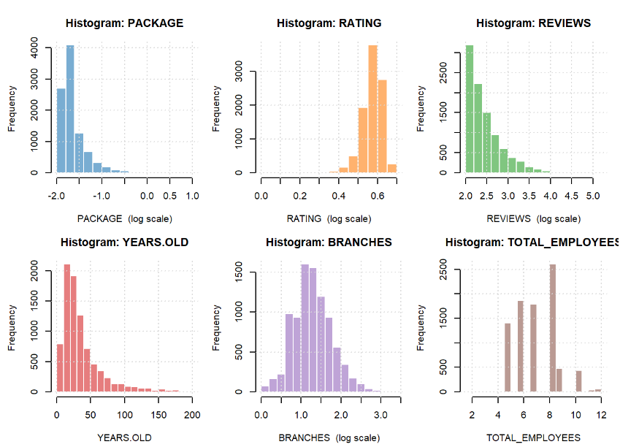
Histogram
Key Observations
  Package, Reviews, and Employees show strong right-skewness → many small companies, few very large ones.
  Rating is tightly concentrated between 3–4, with low variance.
  Years Old shows most companies are relatively young, with a long tail of older firms.
  Branches is moderately skewed; majority have 1–3 branches.

Slide 6
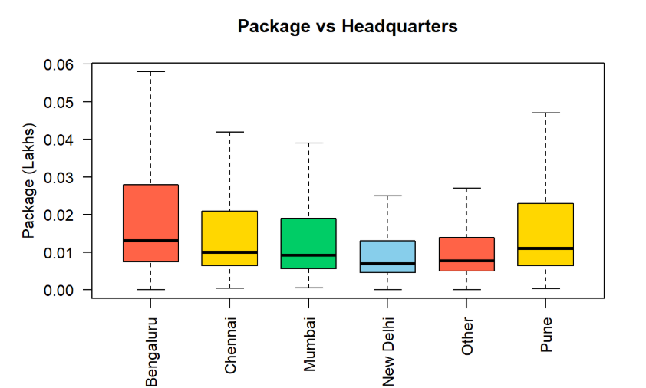
Boxplots
Key Observations
  Bengaluru Offers the Highest Packages
    Highest median salary among all HQ locations.
    Also shows the greatest spread
  Chennai and Mumbai Follow Next
    Moderate median packages.
    More consistent, less volatile compared to Bengaluru.
  New Delhi & Other Locations Have Lower Packages
    Lower median compensation.
    Smaller spread suggests fewer high-paying firms.
  Pune Shows High Variability
    Some companies offer very competitive packages.
    Overall median slightly higher than Delhi/Other.

Slide 7
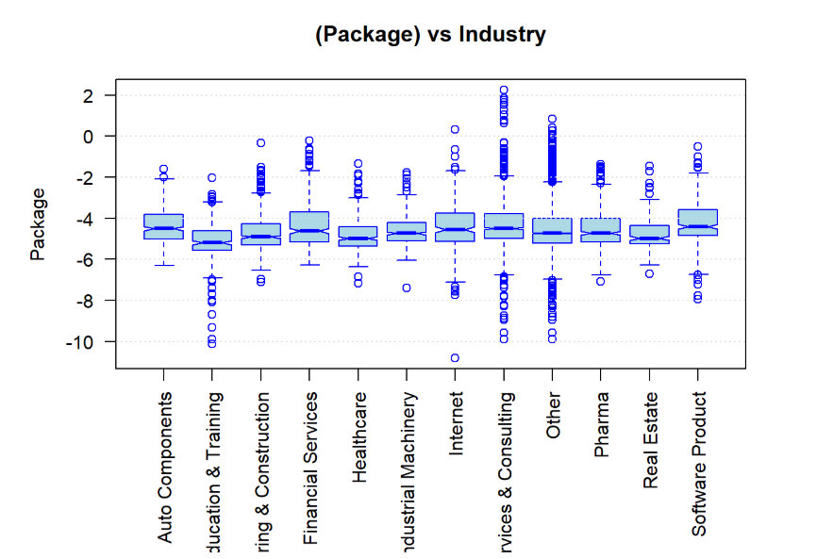
Boxplots
Key Observations
  Industries differ noticeably in average salary levels
  Financial Services, Internet, Software Product → higher packages.
  Education & Training, Construction, Healthcare → lower packages.
  Some industries (e.g., Consulting, Other) show wide variability.
  Log scale helps reveal differences more clearly.

Slide 8
Hypothesis Testing
1
Is the average company rating different from 3.5?
3
Does average package differ by industry?
  H₀: Mean rating = 3.5
  H₁: Mean rating ≠ 3.5
  H₀: All industries have the same mean package
  H₁: At least one industry differs
2
Do Bangalore and non Bangalore companies differ in package?
4
Are industry and headquarters location independent?
  H₀: Industry and HQ are independent
  H₁: They are dependent
  H₀: μ_Bangalore = μ_NonBangalore
  H₁: μ_Bangalore ≠ μ_NonBangalore

Slide 9
Key Findings From Hypothesis Testing
  Average company ratings are significantly higher than 3.5.
  Bangalore companies offer higher salary packages than companies in other cities.
  Industry has a strong and significant impact on package levels.
  Industry and HQ location are closely associated (certain industries cluster in certain cities).
  Company age shows almost no relationship with the salary package — effect is negligible.

Slide 10
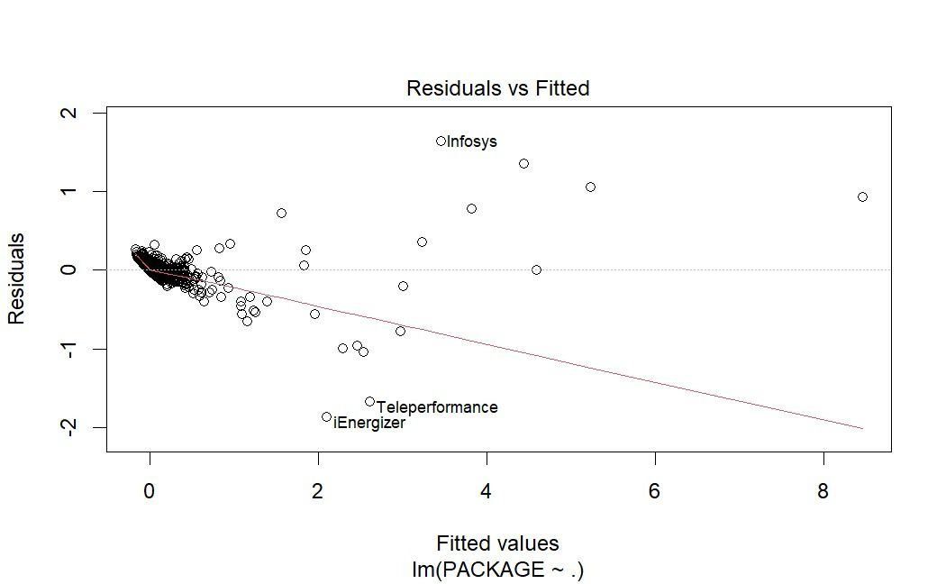
Residuals vs Fitted (Before Transformation)
Key observation:
Clear funnel / cone-shaped pattern, with residual spread increasing at higher fitted values.
Indicates a clear case of heteroscedasticity.
Some firms (e.g., Teleperformance, infosys) lie far from the regression line → potential outliers.

Slide 11
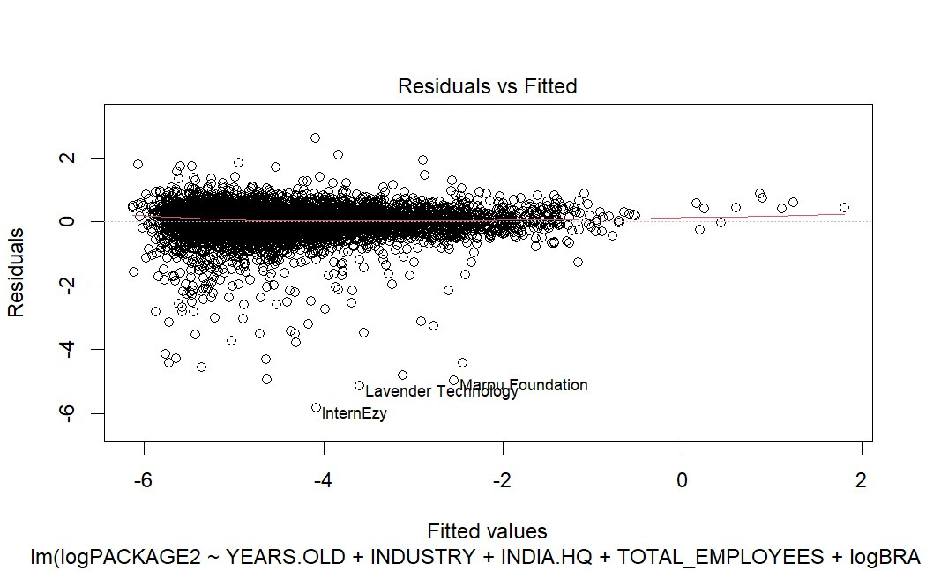
Residuals vs Fitted (After Log Transformation per Box-Cox λ ≈ 0)
Key observation:
  Spread of residuals is now much more uniform across fitted values.
  Heteroscedasticity visibly reduced.

Slide 12
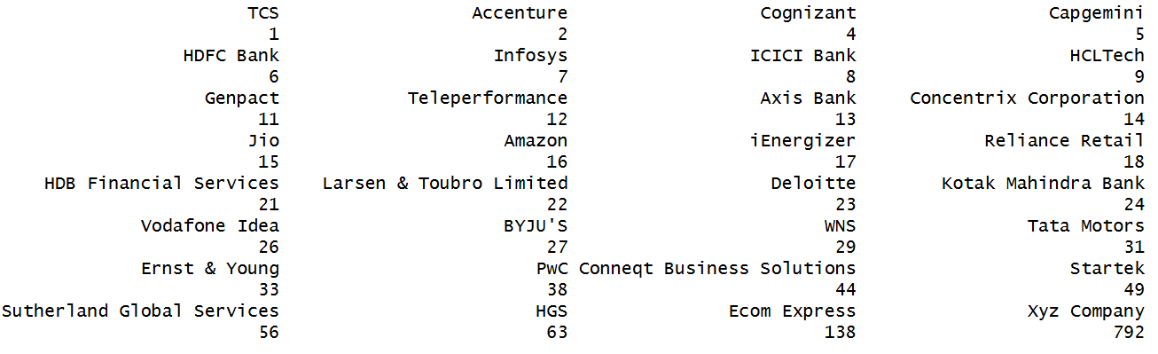
Outlier Detection: Jackknife Residuals
Key observation:
  A large set of firms exceeded the cutoff, including TCS, Accenture, Cognizant, HDFC Bank, Infosys, ICICI, Amazon, Deloitte, PwC, Vodafone Idea, BYJU’s, WNS, Tata Motors, etc.
  Many outliers ≠ many influential points.

Slide 13
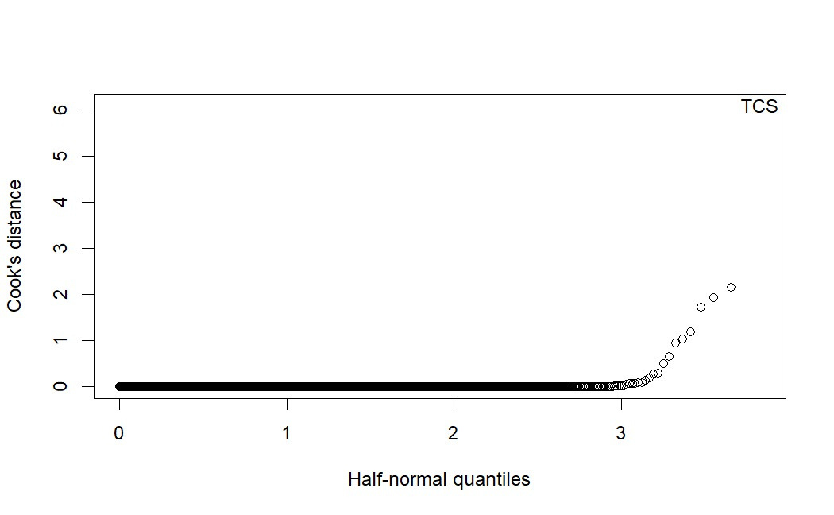
Cook’s Distance (Influence Plot)
Key observation:
  One clear influential company: TCS (far beyond the reference line).
  Remaining points lie near 0 → not influential, even if residual outliers.

Slide 14
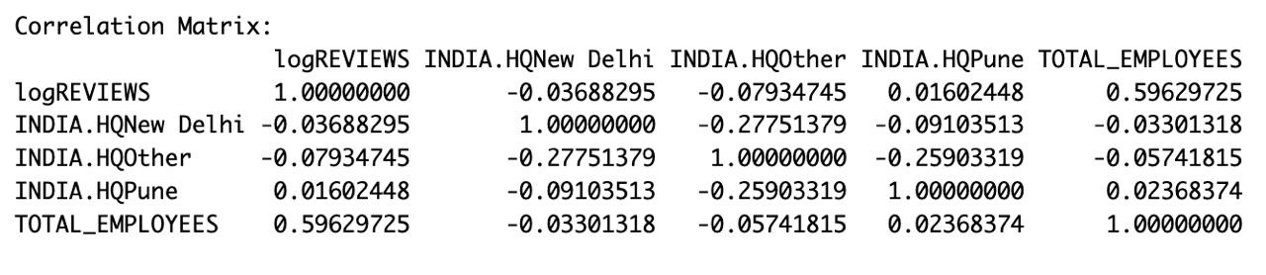
Checking Multicollinearity
1
Correlation Matrix
2
Condition Number
3
VIF
4
Conclusion: NO SIgnificant sign of multicollinearity

Slide 15
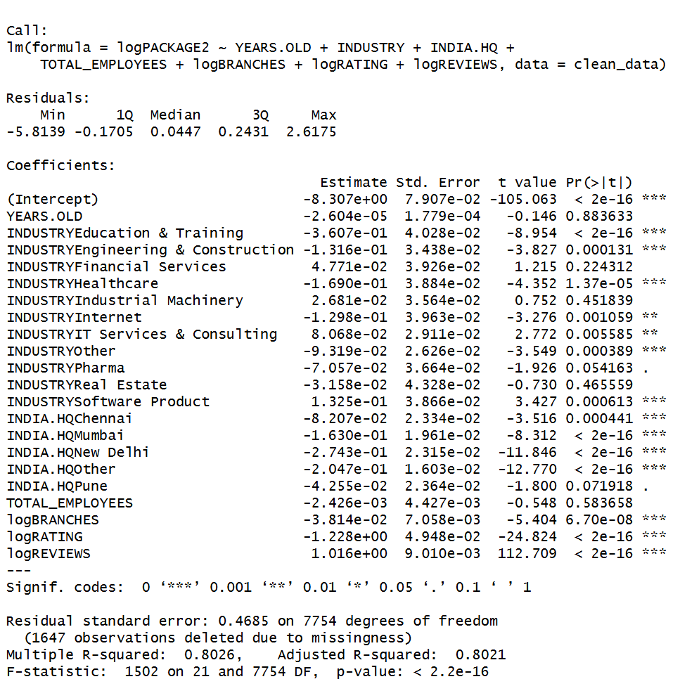
Final Model Summary

Slide 16


Model Selection
(BIC-Based Hybrid Approach)
  Used a hybrid stepwise method guided by BIC to choose the best predictors.
  BIC recommended removing Total Employees and Years Old (low contribution).
  Removing them caused no significant drop in Adjusted R², so the simpler model was preferred.

Slide 17

PREDICTION

Slide 18
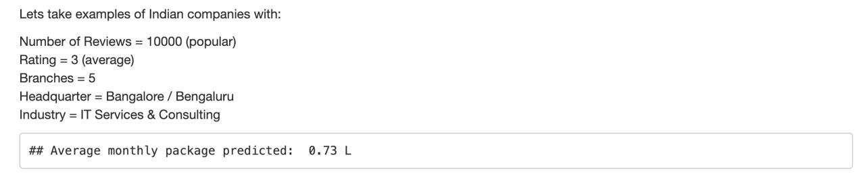
Prediction 1
A Bengaluru-based IT Services firm with moderate ratings and strong presence is expected to offer around ₹73,000 per month.

Slide 19
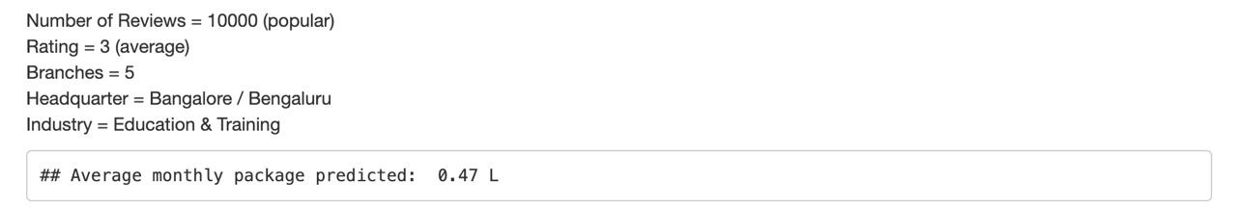
Prediction 2
Even with the same company size and rating, firms in Education & Training offer lower salaries compared to tech or consulting industries.

Slide 20

Thank You

